Slide 1
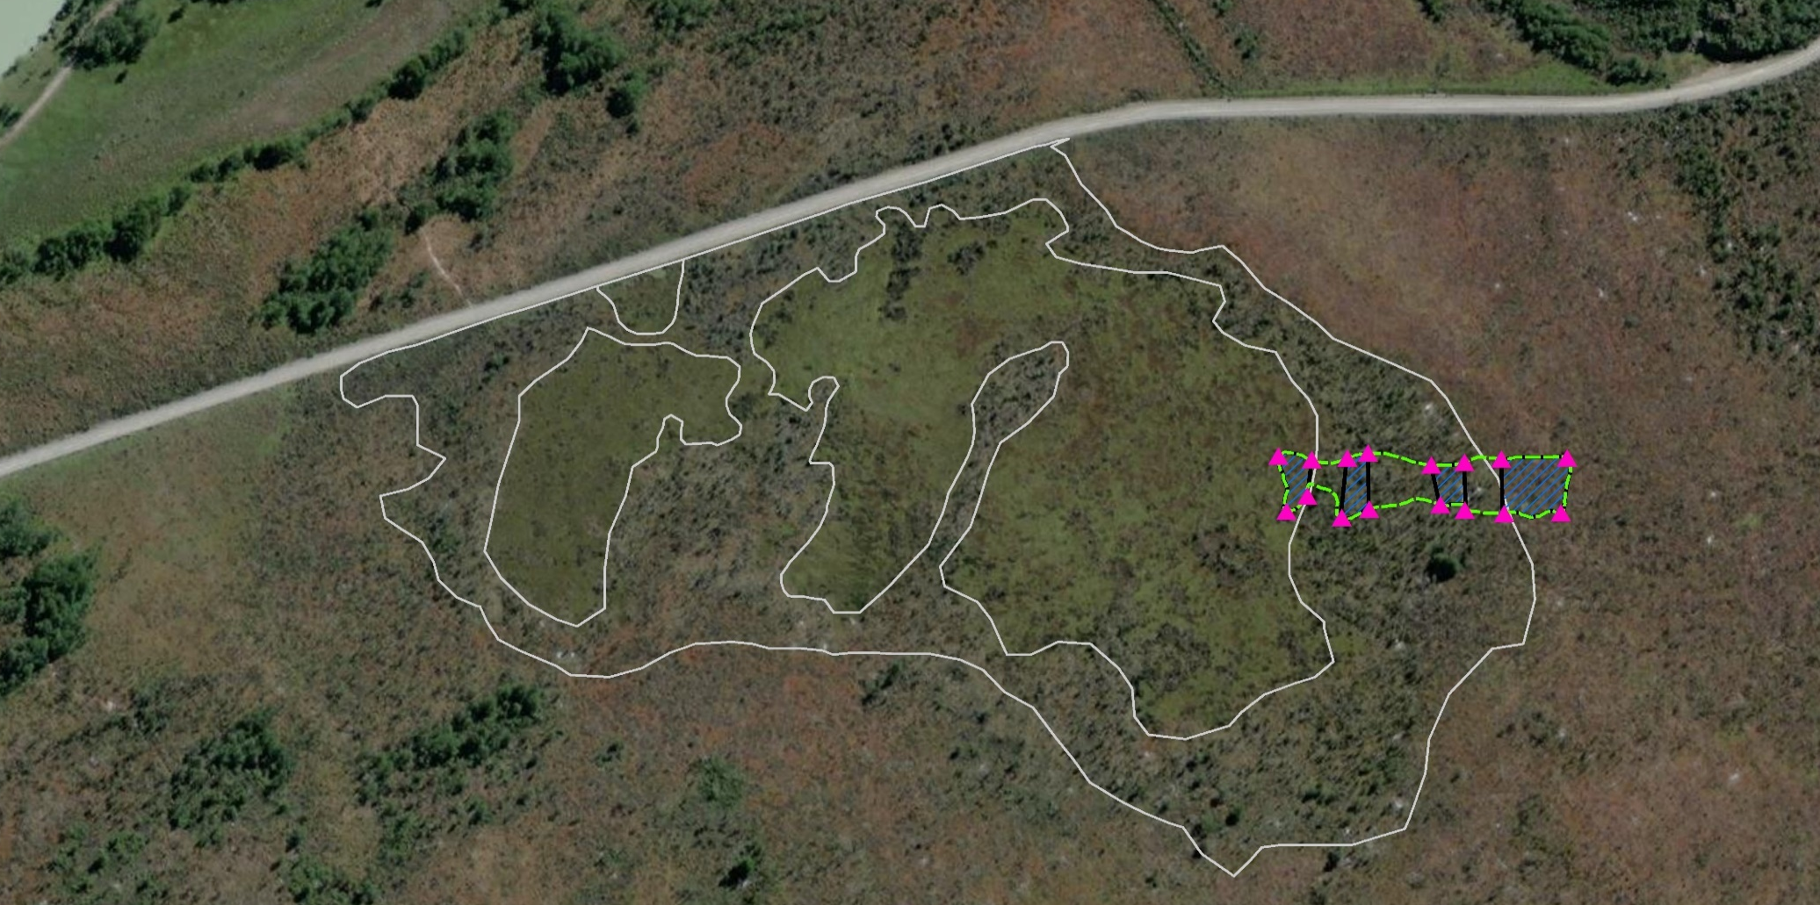
Experimental Plantation, Burned Site
In March 2013, 276 seedlings that were grown from cuttings were established along a drainage gradient across three patches (from left to right, Cushion, Transition, Burned Forest). Seedlings were systematically grouped along transects into seven treatments representing differences in naturally-occurring microsite topography and substrate type that varied by patch: Cushion – pool or lawn; Transition – Sphagnum magellanicum or other substrate; Burned Forest – low, medium or high position (relative to the water table) on an S. magellanicum hummock. Repeat measurements/observations were made of each seedling across the following seasons (though not all measurements were made in all seasons): March 2013, March 2014, February 2016, March 2017, March 2018 and March 2019. Seedling response variables of greatest interest include the following: survival, vigor, total height, and distance from substrate surface to seedling tip.

Slide 2
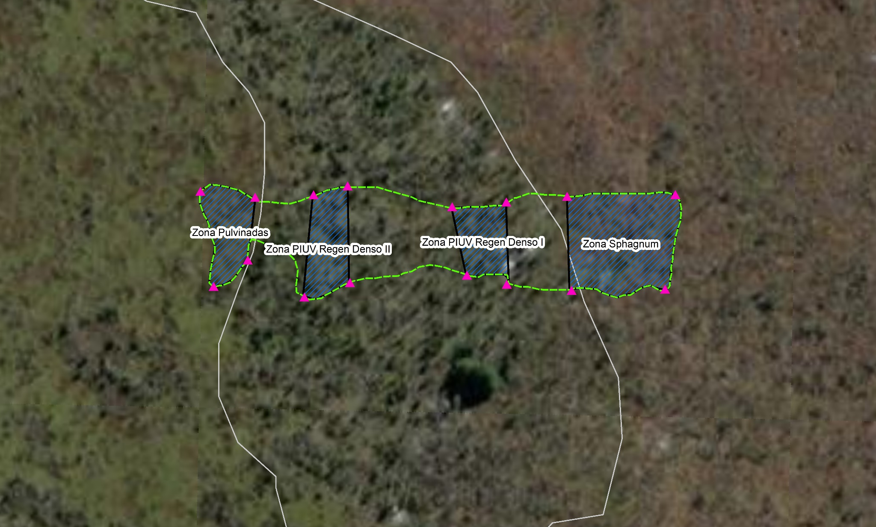
Experimental Plantation:

Slide 3
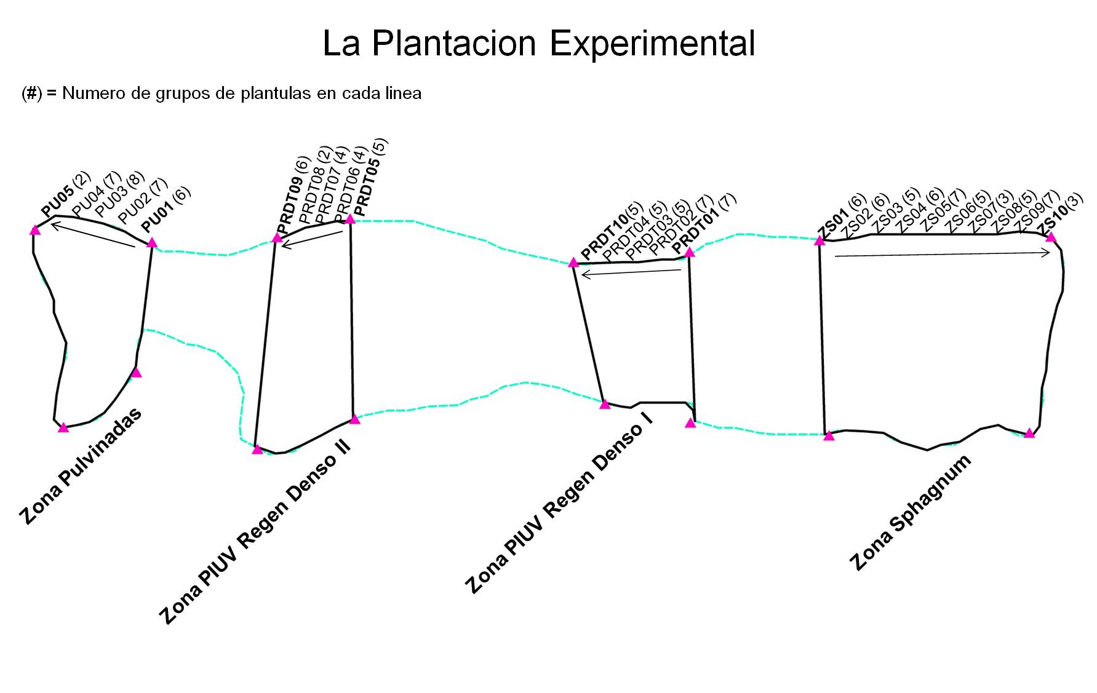
Cushion
Transition
Transition
Burned Forest
Nos. of groups of seedlings per transect in parentheses; in some instances, seedlings were established singly (i.e., not grouped with another seedling or seedlings).

Slide 4
Experimental Plantation:
Treatments in Burned Forest Patch
Transects:
1
2
3
4
5
6
7
8
9
10
Group of 3
seedlings at L, M and H positions on a
Sphagnum hummock.
Individual / un-grouped
seedling, usually in “low” position due to absence of hummock.
(4)
(4)
(4)
Nos. in () represent number of groups of multiple seedlings. Diagrams of seedlings only shown for transects 1 – 3.

Slide 5
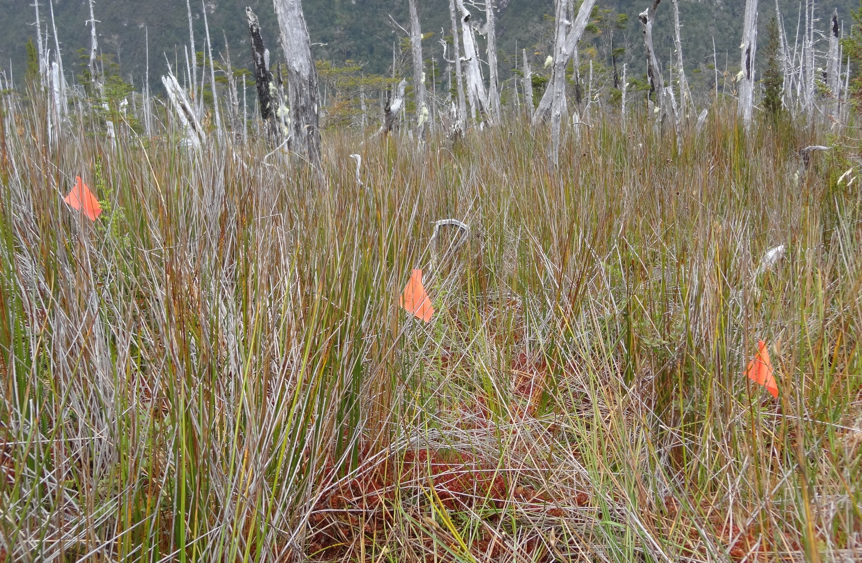
Experimental Plantation:
Treatments in Burned Forest Patch
High
Medium
Low

Slide 6
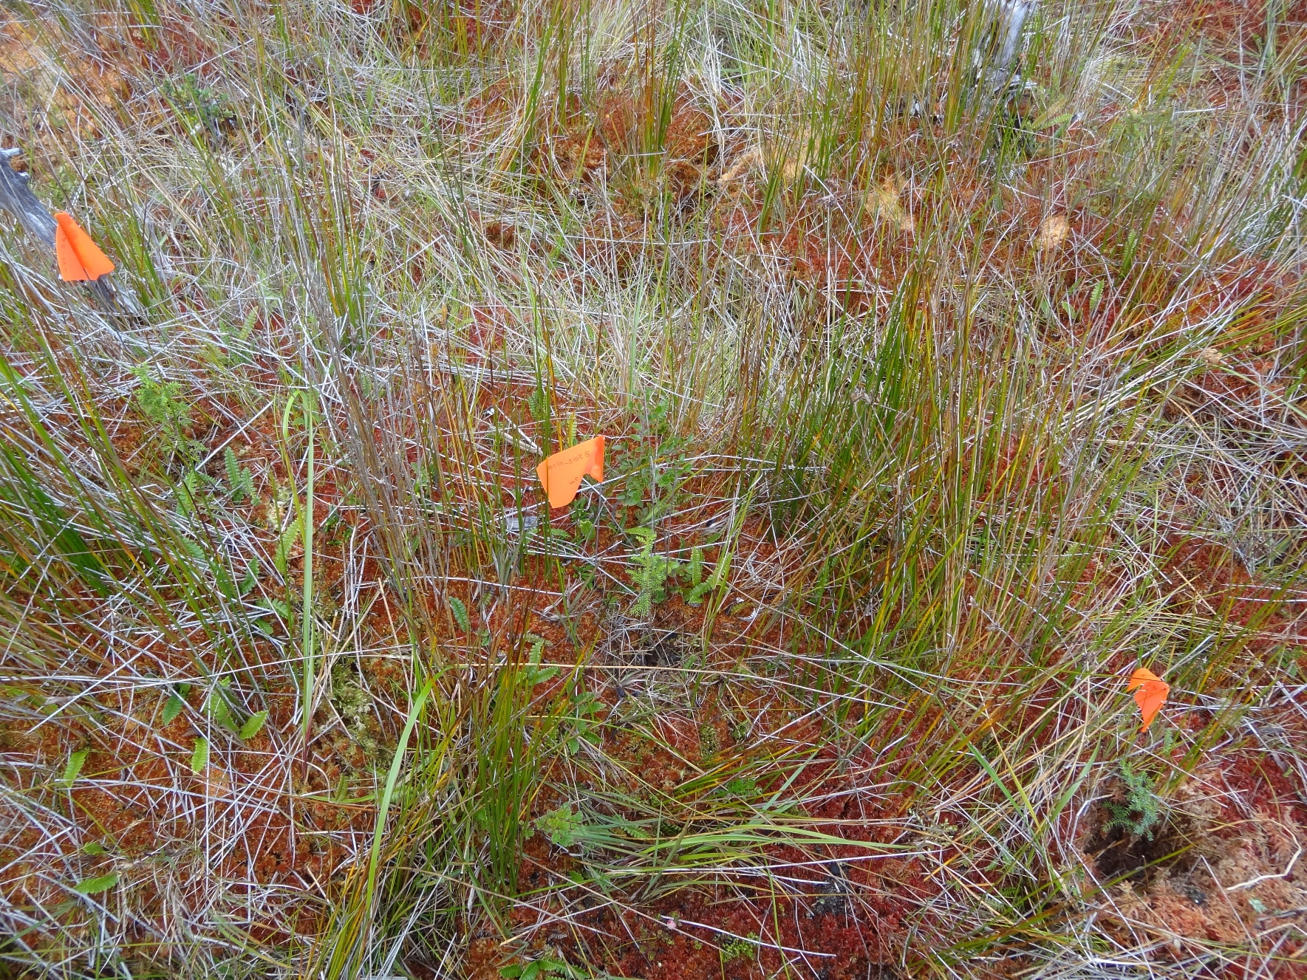
Experimental Plantation:
Treatments in Burned Forest Patch
High
Medium
Low

Slide 7
Experimental Plantation:
Treatments in Transition Patch (eastern area)
Transects:
10
4
3
2
1
Seedling on Sphagnum mat
Seedling on other substrate
Nos. in () represent numbers of seedlings
established in pairs.
(4)
(5)
(4)
(2)
(2)

Slide 8
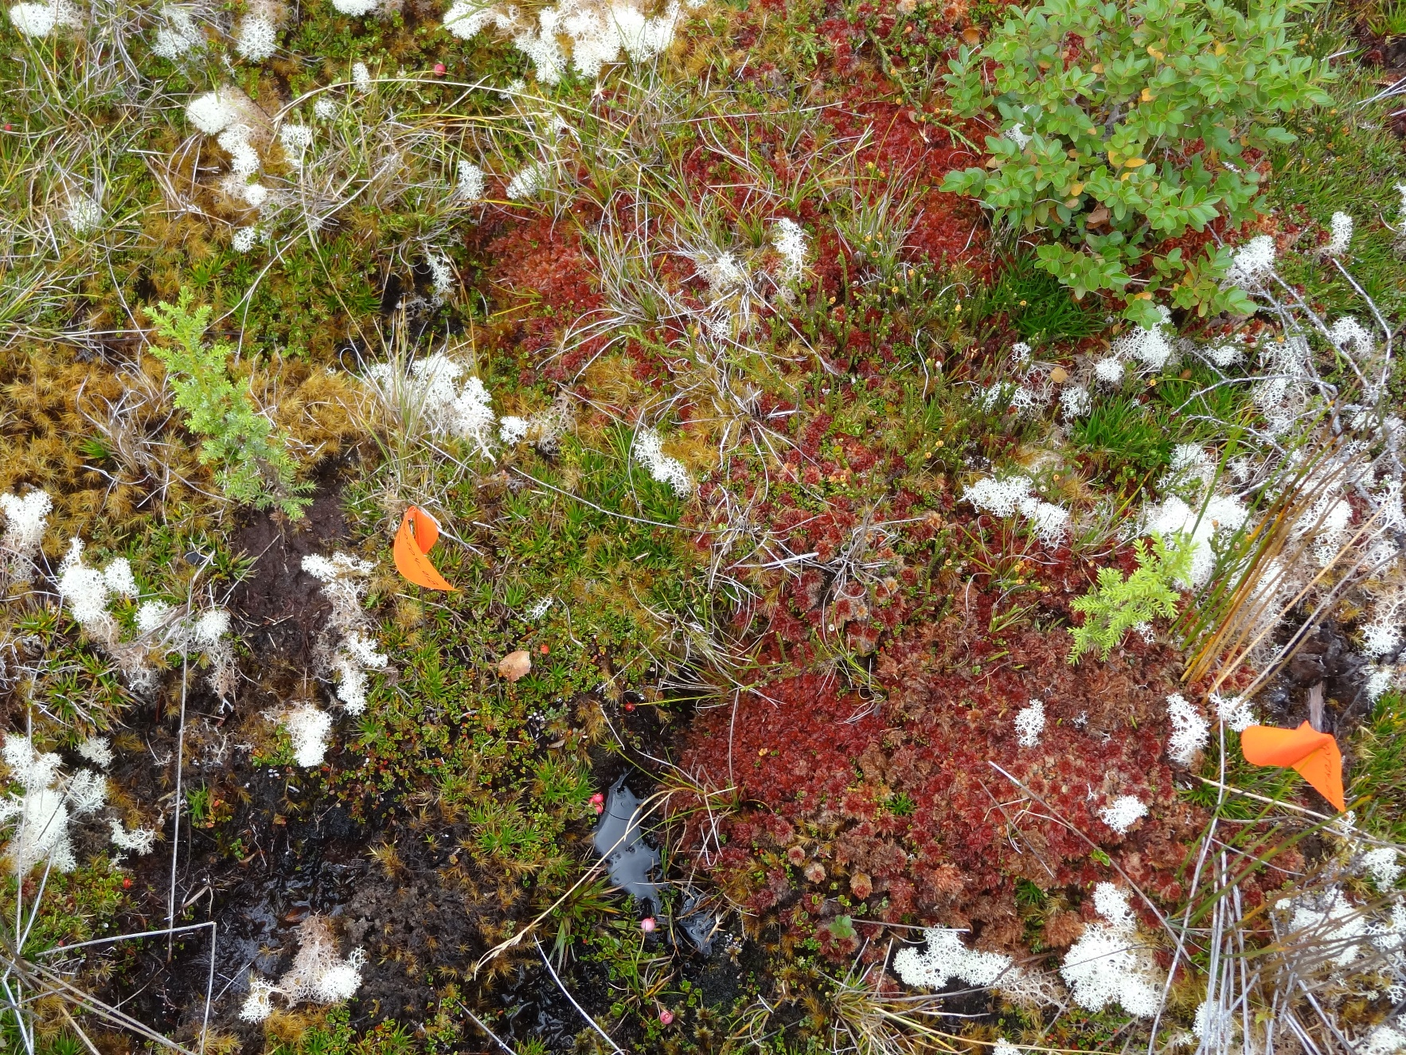
Experimental Plantation:
Treatments in Transition Patch
Non-Sphagnum
Sphagnum

Slide 9
Experimental Plantation:
Treatments in Cushion Patch
Transects:
5
4
3
2
1
Seedling in pool
Seedling on Cushion spp. lawn
Nos. in () represent numbers of seedlings
established in pairs.
(2)
(7)
(8)
(7)
(6)

Slide 10
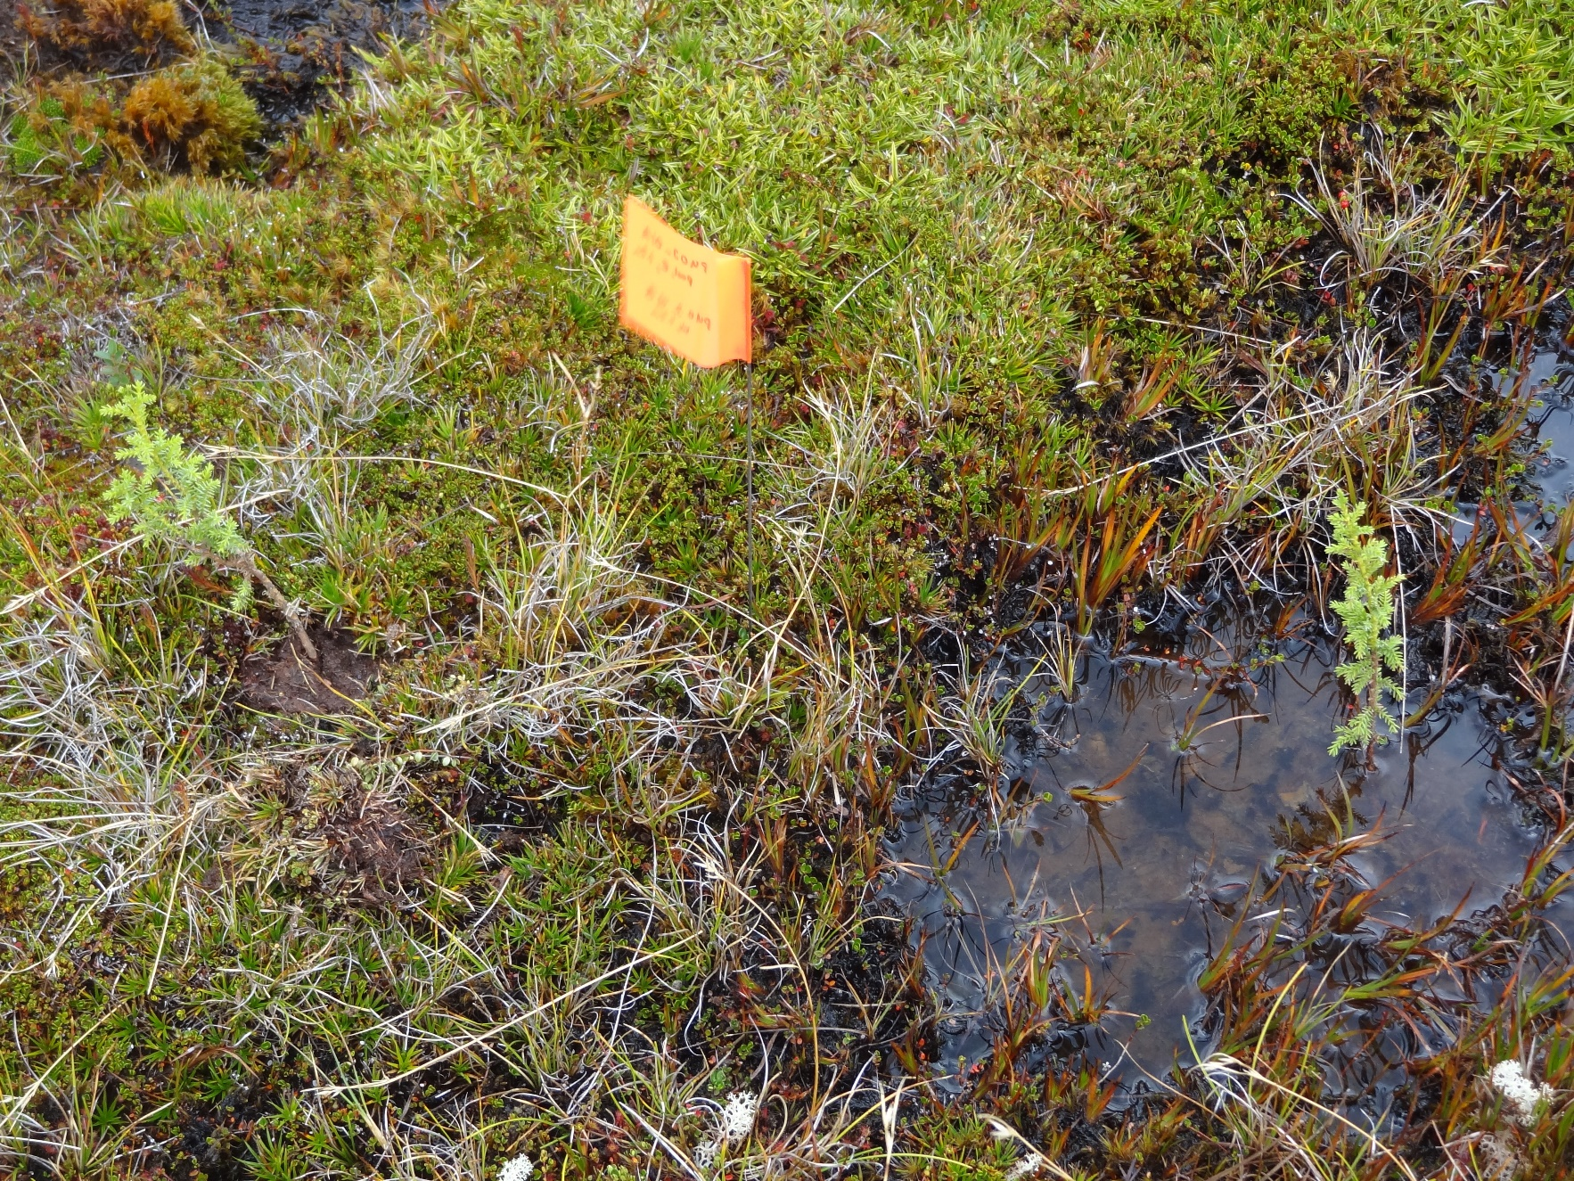
Experimental Plantation:
Treatments in Cushion Patch
Lawn
Pool

Slide 11
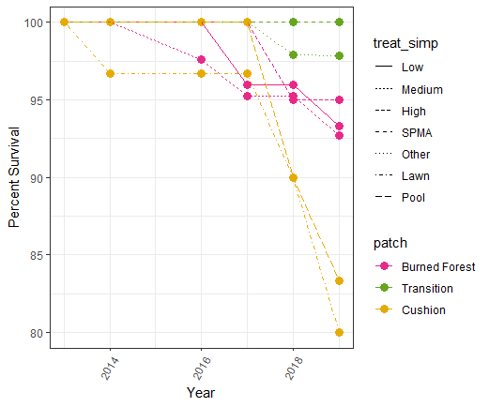

Slide 12
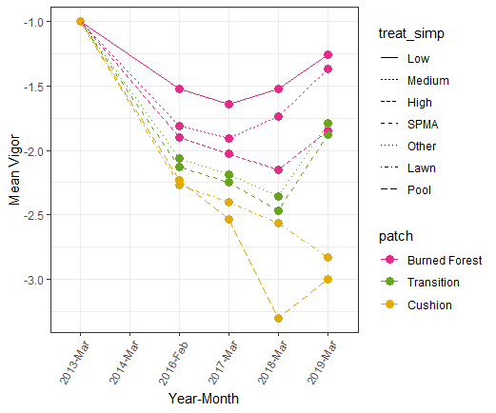

Slide 13
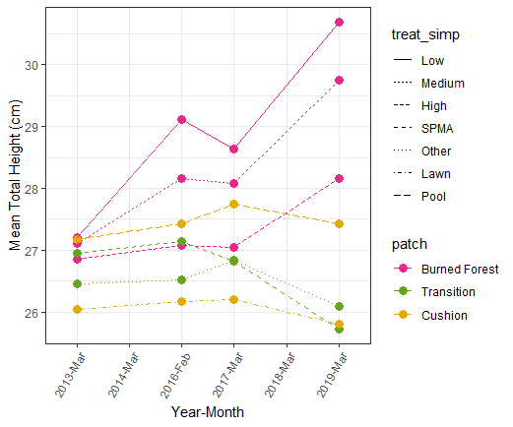

Slide 14
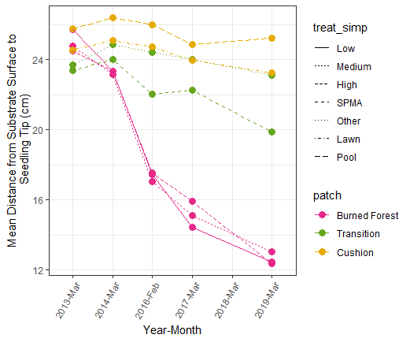

Slide 15
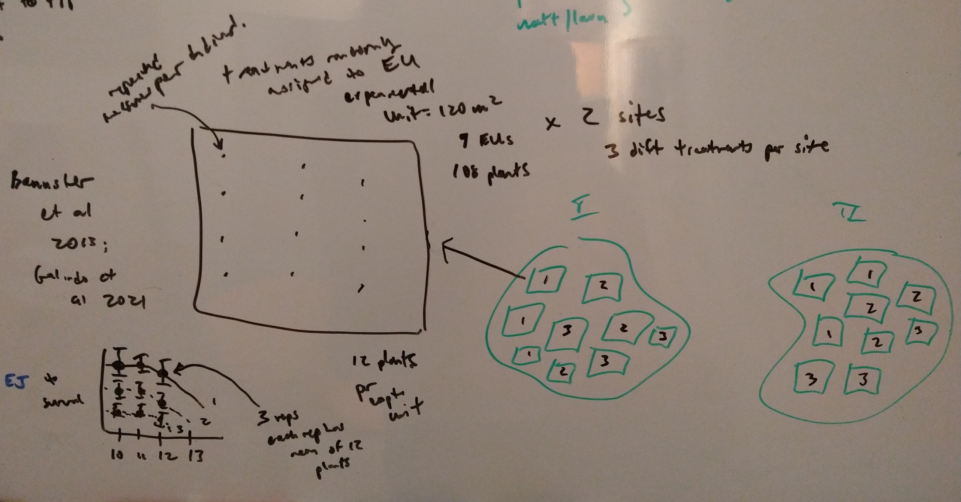
Galindo et al. 2021 Experimental Plantation

